Slide 1
Evaluation of PPP Authentication Protocol Enhancements: A Comparative Analysis of PAP, CHAP, and EAP
Group Members: Justin Paul Misagal, Jose Andreo Canilao, Gabriel Segura

Slide 2
Goal of the Study
This study aims to compare existing PPP authentication protocols specifically Password Authentication Protocol (PAP), Challenge Handshake Authentication Protocol (CHAP), Extensible Authentication Protocol (EAP), and determine the strengths and weaknesses of each protocol.

Slide 3
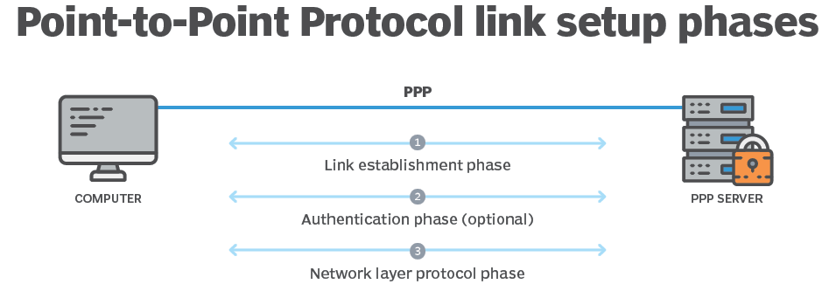
Point to Point Protocols (PPP)
Point-to-point protocol is a means of direct communication between two nodes, bypassing networking processes and operating on the data link layer.
PPP suite operations typically involve a version or implementation of three basic protocols
Link Control Protocol, Network Control Protocol and Authentication Protocol

Slide 4

Authentication Protocols in PPP
Important element in PPP, ensuring secure connection between devices
process of verifying the identity of an entity trying to establish a connection to gain access to resources or gain elevated privileges.
Without authentication, malicious actors may attempt to obtain sensitive information, fabricate data, or disrupt services in a network.

Slide 5
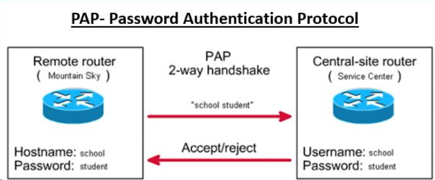
Pass Authentication Protocol (PAP)
a point-to-point protocol (PPP) authentication method that uses passwords to validate users.
Two-way handshake (Client sends credentials and Server responds)
RFC 1334 mentioned that it is not a strong protocol
Sends password over the circuit as plaintext (without encryption)

Slide 6
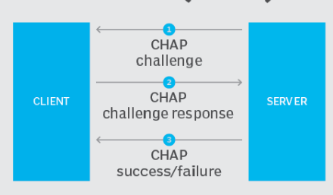
Challenge Handshake Authentication Protocol (CHAP)
Uses a three-way handshake challenge mechanism
Sends a challenge message
Challenge response is compared with the hash value
If the response matched then success otherwise terminate connection

Slide 7
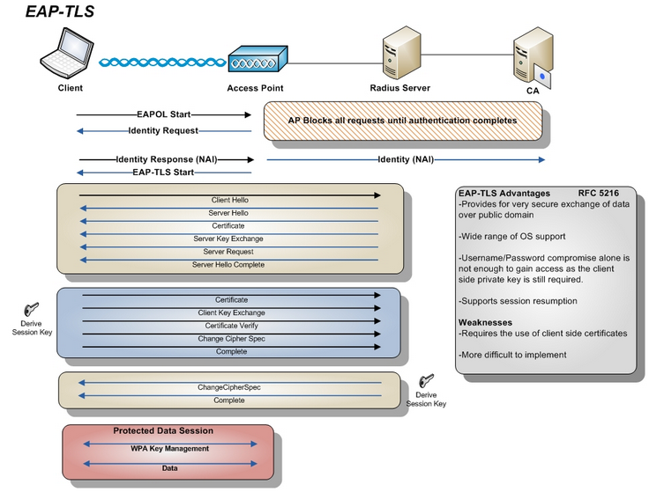
Extensible Authentication Protocol - Transport Layer Security (EAP-TLS)
Uses Transport Layer Security (TLS) to provide an encrypted connection for communication and uses certificates for authentication.
Client sends a Hello message to the Server providing encryption options, and Server responds with certificate generated by choosing an encryption option provided by Client.
Unique session identifiers are assigned to both client and server to streamline client session resumption.

Slide 8
ChatGPT Comparative Analysis

Slide 9
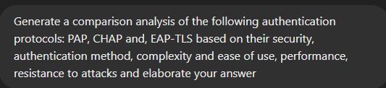
ChatGPT Prompt

Slide 10
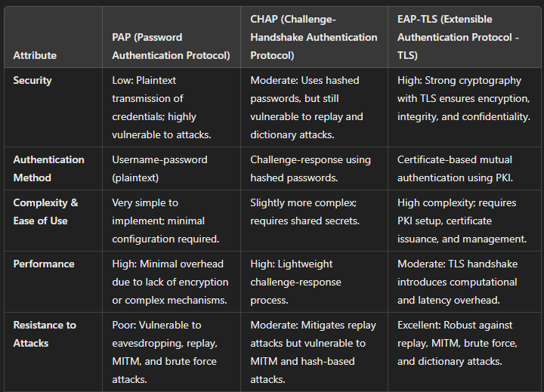
Comparative Analysis of ChatGPT on the Three Authentication Protocols

Slide 11
ChatGPT on Password Authentication Protocol (PAP)
Security: Low security due to transmitting passwords in plain text
Authentication Method: User-name password(in plain text)
Complexity and ease of use: Simple to implement and requires minimal configuration
Performance: High performance due to lack of encryption and complex mechanisms
Resistance to attack: Poor resistance, Vulnerable to eavesdropping, replay attacks, MITM and brute force attacks

Slide 12
ChatGPT on Challenge Handshake Authentication Protocol (CHAP)
Security: Moderate security, Uses hashed-passwords
Authentication Method: Challenge-response using hashed passwords
Complexity and ease of use: Slightly more complex; requires shared secret
Performance: High performance as it used lightweight challenge-response process
Resistance to attack: Moderate Resistance, Mitigates replay attack but vulnerable to MITM and hash-based attacks

Slide 13
ChatGPT on Extensible Authentication Protocol - TLS (EAP-TLS)
Security: High security, Strong cryptography with TLS ensures encryption, integrity, and confidentiality.
Authentication Method: Certificate-based mutual authentication using PKI
Complexity and ease of use: High Complexity as it requires PKI setup, certificate issuance, and management.
Performance: Moderate Performance, TLS handshake introduces computational and latency overhead.
Resistance to attack: Excellent resistance, Robust against replay, MITM, brute force, and dictionary attacks.

Slide 14
Comparative Analysis of PAP, CHAP, and EAP based on Existing Relevant Literature

Slide 15
Password Authentication Protocol
Security: Weakest since it uses plaintext to transmit credentials.
Authentication method: Simply compares plaintext username and password to authenticate users.
Complexity and ease of use: Easiest to implement of the three since it only requires basic username and password verification.
Performance: Minimal overhead as it transmits credentials in plaintext.
Resistance to attacks: Most vulnerable authentication protocol since it uses plaintext when transmitting credentials making it susceptible to almost all attacks.

Slide 16
Challenge Handshake Authentication Protocol
Security: Moderate security since it utilizes a challenge-response mechanism with MD5 encryption
Authentication method: Uses challenge-response mechanism to authenticate users.
Complexity and ease of use: Introduces more complexity than PAP due to the challenge-response process which requires hashing.
Performance: Moderate overhead due to the challenge-response mechanism.
Resistance to attacks: Prevents eavesdropping, however, it can be vulnerable to dictionary and brute force attacks.

Slide 17
Extensible Authentication Protocol TLS (EAP-TLS)
Security: Strongest due to the use of TLS and X.509 certificate-based authentication
Authentication method: Relies on digital certificates for user authentication.
Complexity and ease of use: Most complex authentication protocol among the three since it requires Public Key Infrastructure (PKI).
Performance: Highest overhead since it requires a full TLS handshake, certificate validation, and key generation.
Resistance to attacks: Provides robust resistance to attacks due to strong encryption, mutual authentication, and use of unique session identifiers.

Slide 18
Comparison of ChatGPT’s Answer and Existing Literature
The response provided by ChatGPT coincides with the information found in existing literature regarding the authentication protocols.
However, ChatGPT did not provide any references which challenges the reliability of the information used in generating its response.
Based on the results PAP was ruled as the least secure, CHAP as more secure than PAP, and EAP-TLS as the most secure.

Slide 19
Conclusion
PAP and CHAP are far less secure in terms of encryption method, authentication process, and attack resistance compared to EAP-TLS
Implementing EAP-TLS is more challenging than the other two
PAP and CHAP is more appropriate in low-power environments while EAP-TLS is recommended for high-security environments.

Slide 20
References
[1] A. K. Singh, S. Kumar, M. Agarwal and S. Nandi, "Survey and analysis of Modern Authentication system," 2016 International Conference on Accessibility to Digital World (ICADW), 2016.
[2] X. Ma, R. McCrindle and X. Cheng, "Verifying and Fixing Password Authentication Protocol," Seventh ACIS International Conference on Software Engineering, Artificial Intelligence, Networking, and Parallel/Distributed Computing (SNPD'06), 2006.
[3] A. Ghilen, M. Azizi and R. Bouallegue, "Integration and formal security analysis of a quantum key distribution scheme within CHAP protocol," 2015 IEEE/ACS 12th International Conference of Computer Systems and Applications (AICCSA), pp. 1-7, 2015.
[4] V. Kotal, Principles, implementation and transition to IPv6 protocol, Charles University, 2005.
[5] J. Saranya, "A Study on point-to-point protocol in Data Communication and Networking," International Journal of Computer Sciences and Engineering , pp. 574-576, 2019.
[6] L. Huang, Y. Huang, Z. Gao, J. Lin and X. Jiang, "Performance of Authentication Protocols in LTE Environments," 2009 International Conference on Computational Intelligence and Security, pp. 293-297, 2009.
[7] W. Simpson, "PPP Challenge Handshake Authentication Protocol (CHAP)," August 1996. [Online]. Available: https://www.rfc-editor.org/rfc/rfc1994.
[8] W. Simpson, "PPP Authentication Protocols," October 1992. [Online]. Available: https://datatracker.ietf.org/doc/html/rfc1334.
[9] W. Simpson, "The Point-to-Point Protocol (PPP)," July 1994. [Online]. Available: https://www.rfc-editor.org/rfc/rfc1661.
[10] D. Perkins, "Requirements for an Internet Standard Point-to-Point Protocol," December 1993. [Online]. Available: https://www.rfc-editor.org/rfc/rfc1547.html.
[11]D. Perkins, "The Point-to-Point Protocol for the Transmission of Multi-Protocol Datagrams Over Point-to-Point Links," July 1990. [Online]. Available: https://www.rfc-editor.org/rfc/rfc1171.
[12] J. C. Chen and Y. P. Wang, "Extensible Authentication Protocol (EAP) and IEEE 802.1x: Tutorial and Empirical Experience," IEEE Communications Magazine, vol. 43, no. 12, pp. 26-32, 2005.

